Slide 1

IoT Based Modern Fish Farming Aqua Resource Management System
Project Guide:
Mr. S. Sateesh Kumar (Asst.prof)
Department of CSE
Team 15:
V. Durga poojitha - s180373
J.Rama - s180036
R.Karuna kumari - s180880

Slide 2
Table of contents
Abstract
Keywords
Introduction
Existed system
Disadvantages
Proposed system
Advantages
Hardware requirements
Software requirements
Conclusion

Slide 3
Abstract
Andhra Pradesh is in 1st rank in the production of fish in India which is rich source of vitamins, minerals, protein, nutrients and micronutrients. Farmers found it difficult to manage aqua farms and achieve good yields since we were unable to foresee the water conditions. As a result, an IoT-based solution has been presented that will provide farmers with the real-time, accurate information they need to monitor and maximize their production level. Utilizing water flow control sensors, the architecture of a contemporary aquaculture management system examines water quality and modifies water parameters in real-time. This system comprises of many sensors that gauge temperature, turbidity, pH, and other aspects of the water quality. A microcontroller processes the measured sensor readings and displays changes in Arduino Cloud.

Slide 4
Keywords
IoT – Internet of Things
pH – Potential of Hydrogen
Sensors
Microprocessors
Turbidity
Dissolved Oxygen

Slide 5
Introduction
Aquaculture is the breeding, rearing, and harvesting of fish and other organisms in all types of water environments. India is the world's second-largest producer of fish for aquaculture. About 7% of the world's fish are produced in India. More than 10% of the world's fish biodiversity is found in this nation, which is also 17-mega biodiversity rich countries. A total of 14 million people work in the fishing industry and related industries. The largest fish-producing states in the nation are Andhra Pradesh, West Bengal, and Gujarat. The overall fish production for 2017–18 is 12.60 million metric tonnes, of which almost 50% comes from cultural fisheries and roughly 70% comes from the inland sector. Products made from fish and shellfish in more than 50 distinct varieties are exported to 75 countries around the world.

Slide 6
Methods of Aquaculture
Native Fishes | Number of Species
Marine Ecosystem | 1518
Brackish water Ecosystem | 113
Freshwater Ecosystem | 877
Freshwater Fish: Fish that spend most or all of their life in freshwaters, such as rivers and lakes, having a salinity of less than 0.5 ppt. Around 40% of all known species of fish are found in freshwater..
Brackish water Fish: Fish that can tolerate a wide range of salinity (0.5 – 30.0 ppt) and live in backwaters, estuaries and coastal waters. Example: Mullet, Milkfish, Seabass, Pearlspot, Mudskipper, etc.
Marine Fish: Fish that spend most or all of their life in seawater, such as Seas and Oceans, having salinity above 30 ppt. There are about 240 species contributing to the marine fisheries

Slide 7
Aquaculture in Andhra Pradesh
Andhra Pradesh has been contributing significantly to the fish basket of the country in the recent years through an effective strategy in both coastal and freshwater aquaculture and marketing. The state has 5.17 lakh ha of freshwater ponds and tanks, 11,514 km of rivers and canals, 4.58 lakh ha of reservoirs and 150,000 ha of water areas suitable for coastal aquaculture.
Types of fresh water fishes :
Murrel
Tilapai
Catla
Rohu

Slide 8
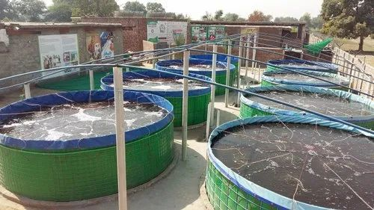
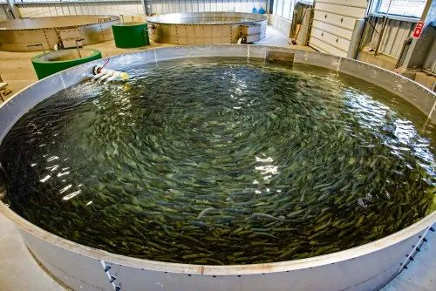
Fish Tanks

Slide 9
Water contamination is one of the key issues we are now experiencing. Dissolved oxygen (DO), total ammonia-nitrogen (ionized and non-ionized), nitrite, pH, alkalinity, hardness, carbon dioxide, salinity, iron, chlorine, hydrogen sulphide, and clarity are the most often observed water quality indicators. To detect these elements, we typically need to personally collect samples, which we then submit to a lab to be tested. As a result, the process is laborious, and it will take a while to analyze the samples. We therefore require a novel approach to combat this issue.
There is a danger that poor water quality will affect the fish growth because they are growing in a small space. Consequently, it is essential to monitor water quality.so that farmers may remotely monitor system modifications and our suggested systems can monitor water quality measurements effectively by using a variety of sensors.

Slide 10
Existed System
Some of the existing technologies used in aquaculture include:
Environmental Monitoring Systems: These systems incorporate sensors to continuously monitor water quality parameters such as temperature, pH, dissolved oxygen, and turbidity. The collected data is analyzed to maintain optimal conditions for fish health and growth. Examples include the use of multi parameter probes, water quality monitoring stations, and automated data logging.
Recirculating Aquaculture Systems (RAS): RAS systems recirculate and treat water, allowing for better control of water quality parameters and reduced water usage compared to traditional flow-through systems. These systems often incorporate monitoring and automation technologies for water filtration, aeration, and waste management.

Slide 11
Disadvantages
Highly expensive
Less accurate.
Not user friendly.
Less efficient.

Slide 12
Proposed System
By integrating the existing systems the proposed system is made for fishermen to monitor the quality of water for a healthy environment for fish to live in. Healthy water is essential for aquatic animals. Water quality is decided by some factors like pH level, oxygen level, temperature etc. Some sensors have been integrated with the proposed system to collect the values of some parameters from the water. For this purpose, pH sensor, temperature sensor, oxygen and turbidity have been used. This system was created by connecting a pH sensor, a temperature sensor, and some other equipment and combining the existing systems.

Slide 13
Advantages
Farmers can accurately monitor and maintain optimal water quality levels, leading to higher yields and better quality fish.
Real-time monitoring: The system continuously monitors the water quality parameters and sends alerts to the farmers in real-time if there is any deviation from the desired conditions. This helps farmers to take corrective actions promptly and prevent any adverse effects on fish health.
Improved yield: By maintaining optimal water quality conditions, the system can help farmers achieve better yields and maximize their profits.
Environmentally friendly: The system helps to minimize the impact of aquaculture on the environment by preventing pollution and eutrophication.

Slide 14
Disadvantages
Cost: Implementing the system may require significant upfront investment costs, including purchasing sensors, microprocessors, and other equipment. The cost may be a barrier for some farmers who are unable to afford the initial investment.
Maintenance: The system will require regular maintenance and monitoring to ensure proper functioning. The sensors may need to be calibrated or replaced periodically, and any malfunctions or breakdowns will need to be addressed promptly to avoid losses.

Slide 15
Hardware Requirements
Sensors to detect viruses, conductivity, pH, and temperature changes in water
Microprocessor to evaluate the measured data from the sensors and send commands to maintain the appropriate water conditions for fish life
Water flow and leve control sensors to regulate the water flow in real-time
Internet connectivity to enable data transmission and monitoring in real-time
Power supply system to power the sensors, microprocessor, and valves
Arduino UNO

Slide 16
Software Requirements:
Embedded programming language such as C or C++
Operating system to support the embedded programming language
Application software for data acquisition and processing
Database management system to store and manage data
Web-based user interface to monitor and control the aqua resource management system

Slide 17
Conclusion
In conclusion, aqua resource management plays a crucial role in enhancing the efficiency, sustainability, and productivity of fish farming operations. By integrating technologies such as sensors, automation, data analytics, and remote monitoring, aqua resource management systems enable real-time monitoring of water quality, disease control, and resource optimization. These systems offer numerous benefits, including improved production efficiency, enhanced fish health and welfare, reduced environmental impact, and data-driven decision making. However, it's important to address potential challenges such as initial investment costs, technical complexity, data security, and user acceptance. With proper planning, training, and ongoing support, aqua resource management systems can drive the growth of a sustainable and profitable fish farming industry.

Slide 18
Thank you

